Slide 1
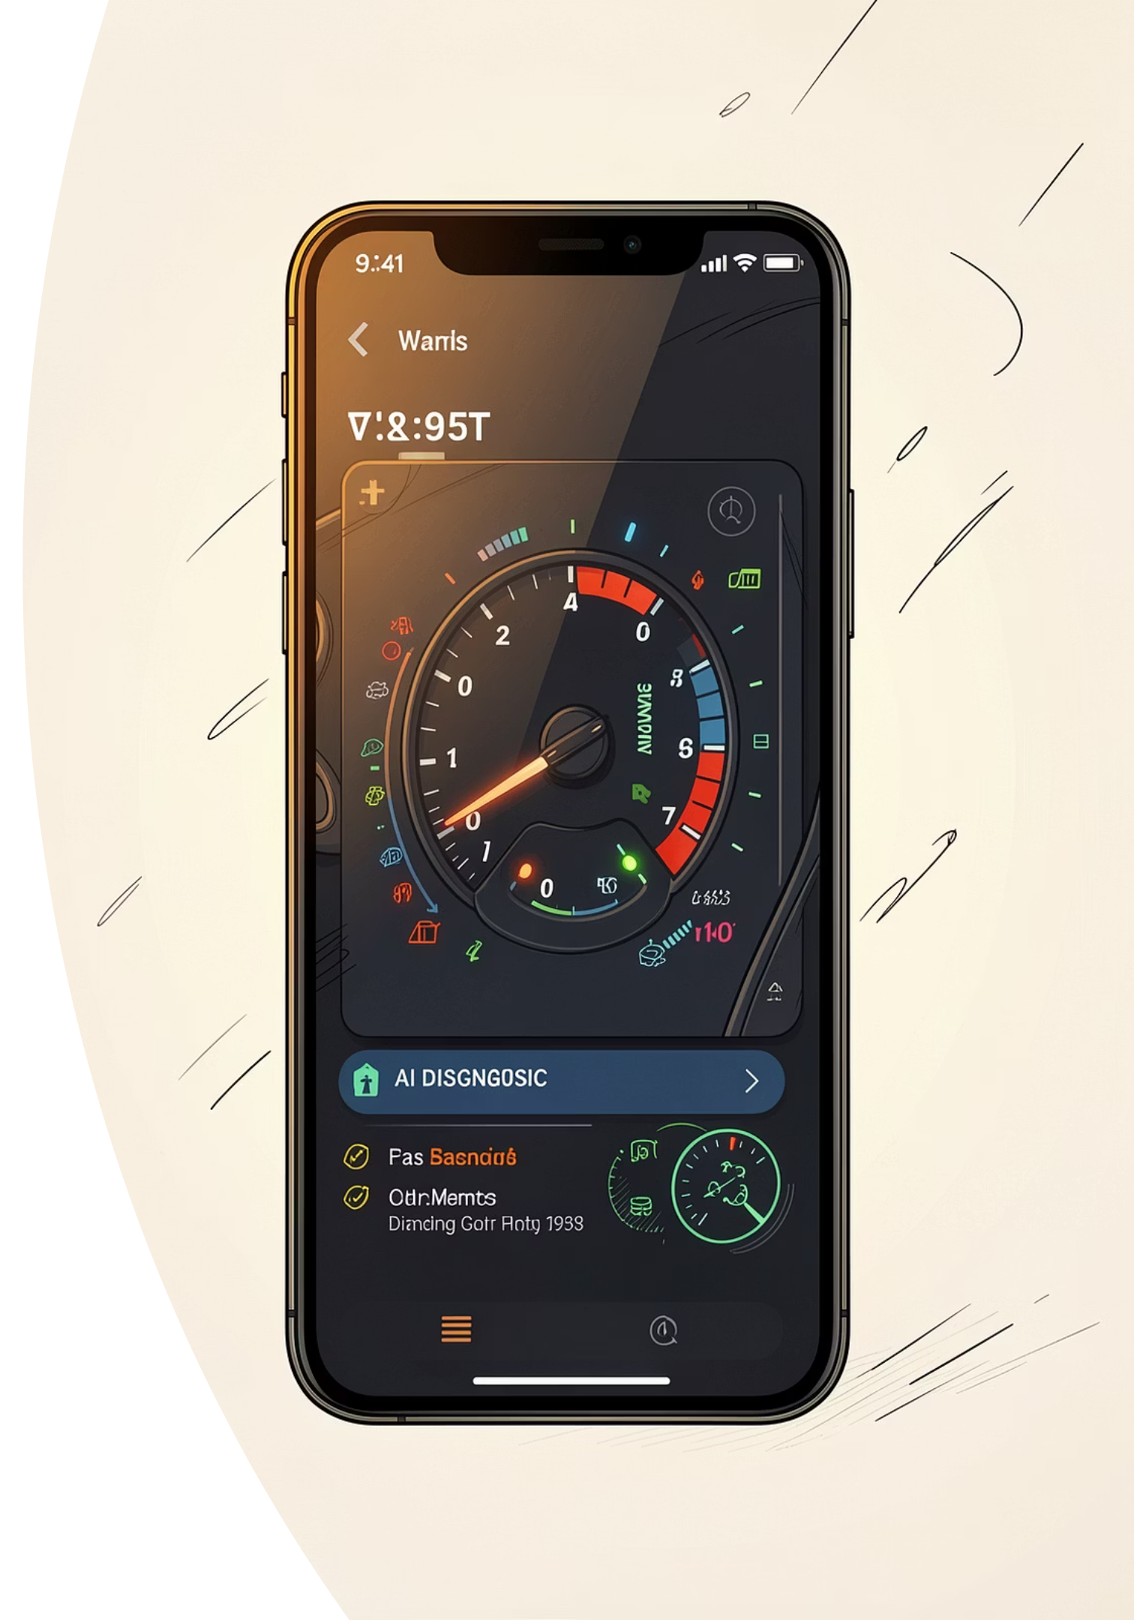
CEF 440 · INTERNET & MOBILE PROGRAMMING
GROUP 8 · UNIVERSITY OF BUEA
CarDiag: System Modelling & Design
Complete UML design phase for an AI-powered mobile car diagnostics app — covering six diagram types grounded in the baselined SRS v1.1.
Instructor: Dr. Nkemeni Valery | Group 8: Salle Yimnai Bryan Nzume Etuge · Fongang Faith Acho · Andigema Joyce Ani · Manikeu Tinkeu Marie Ange Princesse · Ndip Samuel Agbor Ojong

Slide 2
What We'll Cover
Six UML diagrams trace the complete system design — from external actors to physical deployment.
Context Diagram
DFD Level 0
System boundary & external actors
4 processes, 3 data stores
Use Case Diagram
Sequence Diagrams
11 use cases, 3 actors
8 interaction flows
Class Diagram
Deployment Diagram
13 classes, 2 enums
3 runtime nodes
Notes:
Slide 2

Slide 3
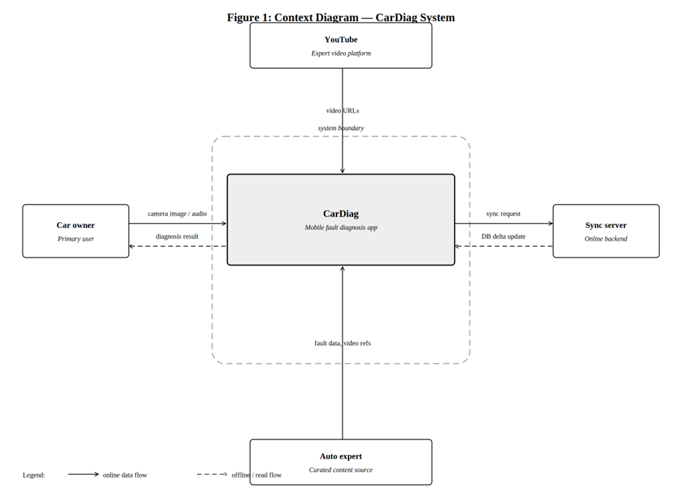
DIAGRAM 1
Context Diagram
System Boundary
CarDiag app — all sensor data stays on-device.
External Actors
Car Owner — primary user; camera, audio, symptom inputs
Sync Server — Version 2 delta updates
YouTube — curated expert video URLs
Automotive Expert — offline KB content source
Slide 2

Slide 4
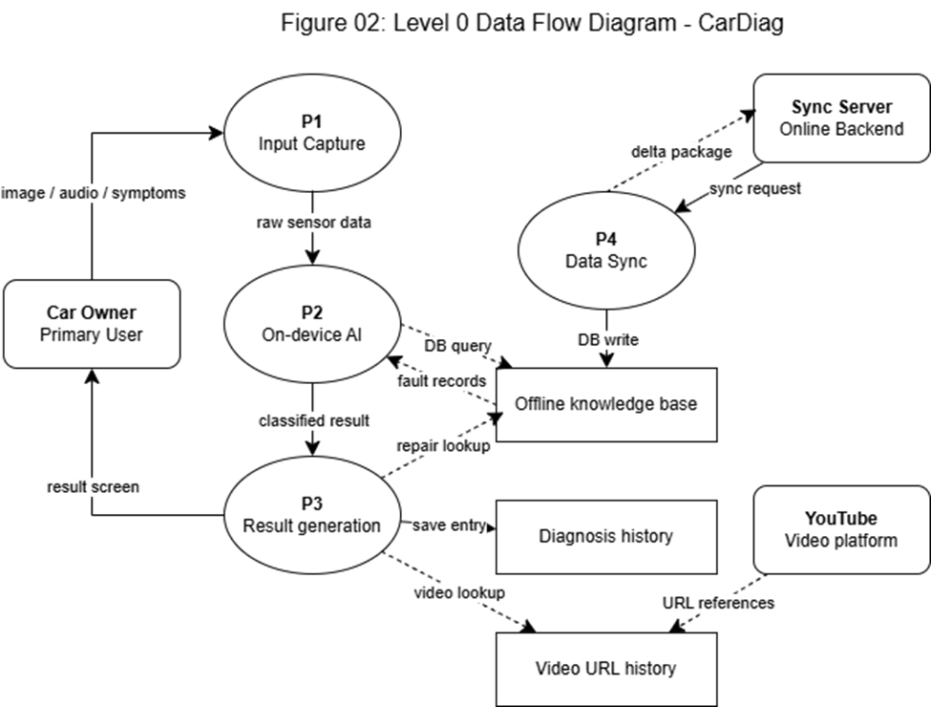
DIAGRAM 2
Data Flow Diagram — Level 0
Processes
P1 Input Capture
P2 On-device AI
P3 Result Generation
P4 Data Sync (V2)
Data Stores
DS1 Offline KB (SQLite)
DS2 Diagnosis History
DS3 Video URL Registry
Slide 2

Slide 5
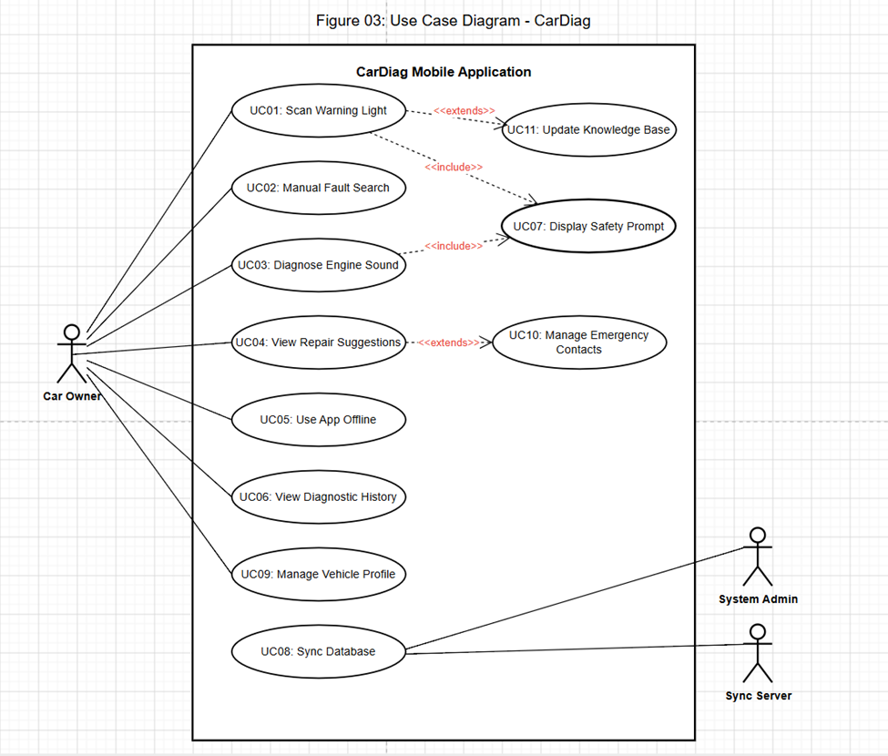
DIAGRAM 3
Use Case Diagram
Actors
Car Owner — primary user
Sys Admin — DB maintenance
Sync Server — V2 backend
Core Use Cases
UC01 Scan Warning Light
UC02 Manual Search
UC03 Engine Sound
UC04 Repair Suggestions
UC05 Offline Use
UC06 History
UC07 Safety Prompt
UC08 Sync DB (V2)
Slide 3

Slide 6
DIAGRAMS 4–11
Sequence Diagrams
Eight diagrams detail interaction flows for each use case.
UC01 · Scan Warning Light
UC02 · Manual Search
Camera → ML classifier → result; low-confidence fallback
Live search under 500 ms per keystroke
UC03 · Engine Sound
UC04 · Repair Suggestions
Safety screen → noise check → MFCC classification
Three-tier guidance; optional video links
UC05 · Offline Use
UC06–08 · History · Safety · Sync
Zero network calls; bundled assets only
Local history; safety modal; V2 sync
Slide 4

Slide 7
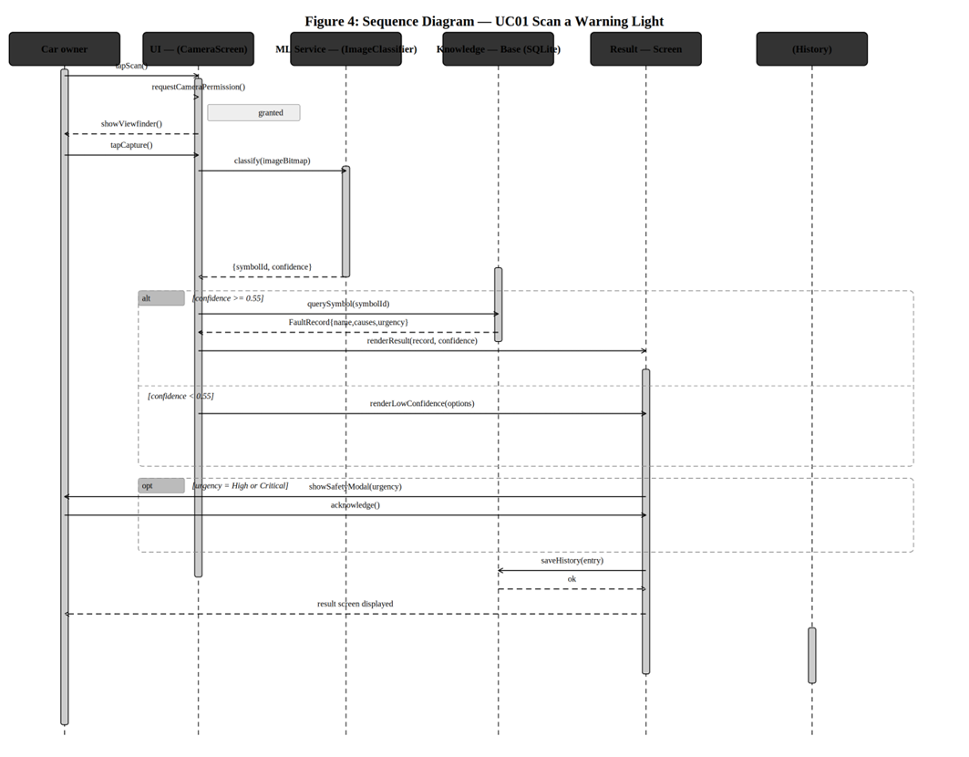
DIAGRAM 5
UC01 · Scan Warning Light
This sequence diagram illustrates the detailed interaction flow for scanning a warning light. The process begins with the Car Owner activating the camera scan within the Mobile App. The app captures the image and sends it to the ImageClassifier (powered by TensorFlow Lite) for analysis. Based on the returned confidence score, the system either directly displays the diagnosis or, if confidence is low, provides a fallback prompt for a manual search, ensuring robust diagnostic capabilities.
Slide 5

Slide 8







DIAGRAM 4
UC03 · Engine Sound Analysis — Sequence Diagram
This sequence illustrates the interaction flow for diagnosing vehicle faults based on engine sound, incorporating user safety prompts and AI processing.
Initiate Audio Capture
Car Owner taps the audio button to start the diagnostic process, indicating intent to record engine sound.
Display Safety Modal
The Mobile App presents a non-dismissible safety modal for 3 seconds, ensuring user awareness of recording.
User Confirmation
The Car Owner explicitly confirms understanding and agreement to proceed after the safety warning timeout.
Record Engine Audio
The Mobile App actively records the engine sound via the device's microphone, capturing raw audio data.
Extract MFCC Features
The AudioClassifier component processes the recorded audio, extracting Mel-frequency cepstral coefficients (MFCC) for analysis.
Classify Fault Type
An integrated ML model analyzes the MFCC features to identify and classify the specific engine fault type.
Provide Diagnosis
The Mobile App displays the diagnosed fault, an urgency level, and tailored repair suggestions to the Car Owner.
Slide 4

Slide 9
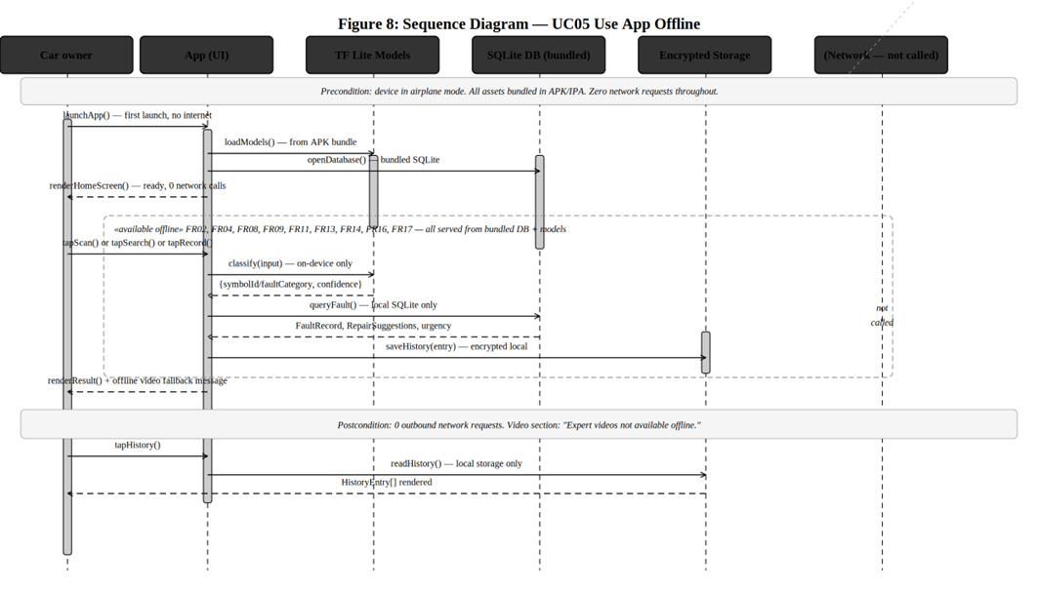
DIAGRAM 13
UC05 · Offline Use — Sequence Diagram
Interaction Flow
This diagram details how the CarDiag app ensures full functionality even without an internet connection:
Owner Initiates: Car Owner opens the application.
Network Check: Mobile App verifies network availability.
Offline Activation: If no connection, all features load from the pre-bundled SQLite Offline Knowledge Base.
Zero Network: No external network calls are made during offline operation.
Full Access: Users can scan warnings, search faults, view history, and access repair suggestions.
Notes:
Slide 13

Slide 10
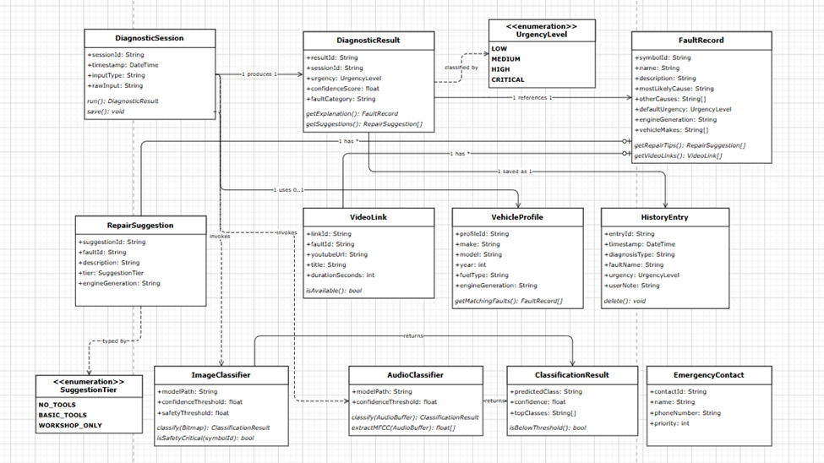
DIAGRAM 12
Class Diagram
Core Classes
DiagnosticSession
DiagnosticResult
FaultRecord
RepairSuggestion
VehicleProfile
HistoryEntry
ML & Support
ImageClassifier / AudioClassifier
VideoLink
EmergencyContact
Enums
UrgencyLevel
SuggestionTier
Slide 12

Slide 11
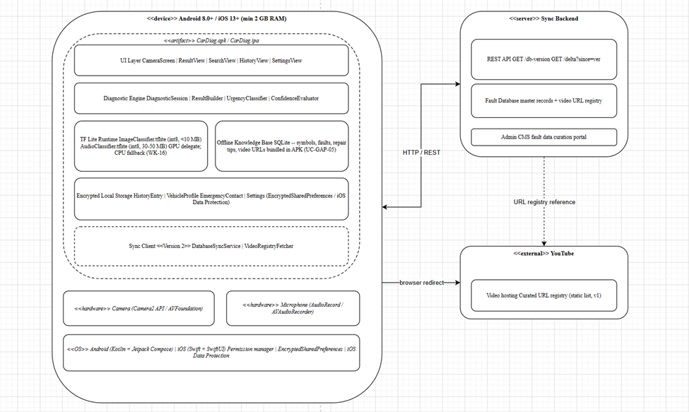
DIAGRAM 13
Deployment Diagram
Mobile Device
Android 8.0+ / iOS 13+ · 2 GB RAM · TF Lite ML · SQLite KB · encrypted storage
Sync Server (V2)
REST API · master DB · admin CMS
YouTube
Curated URLs via browser; no direct API in V1
Security
HTTPS only · no raw sensor transmission
Slide 14

Slide 12

Design Summary
All six diagrams are consistent with SRS v1.1 and incorporate all 20 validation changes from the Buea stakeholder programme.
Offline-First
All core features from first launch — zero network calls required
Safety-Critical
Non-dismissible modals, 3-second delays, emergency contacts
Privacy-First
No sensor data transmitted; encrypted local storage only
Versioned
V1 complete offline; V2 adds sync and video links
Notes:
Slide 2

Slide 13
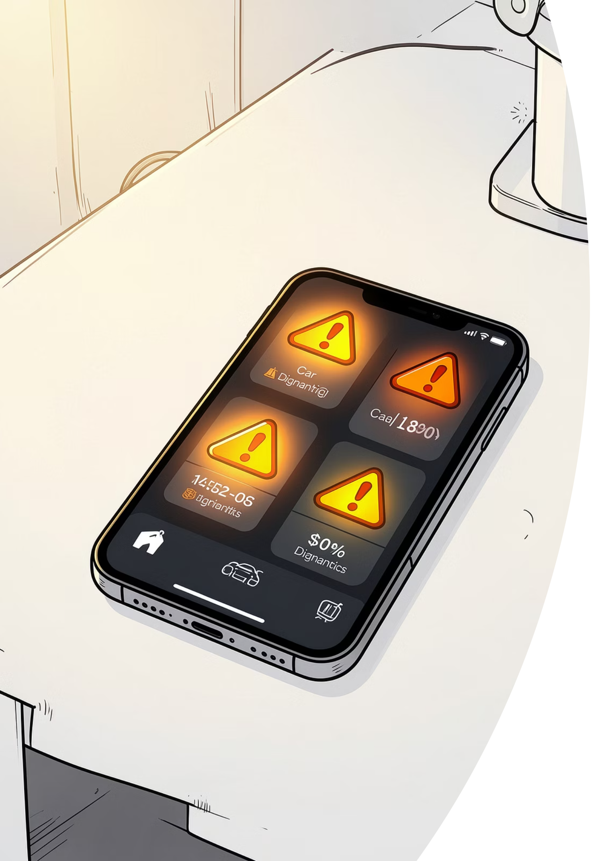

Conclusion & Next Steps
System modelling complete. These six diagrams serve as the primary reference for UI and database implementation.
1
Task 5
UI Design & Implementation
2
Task 6
Database Design & Implementation
All diagrams produced in Draw.io (diagrams.net). Source .drawio files in project repository. References: CarDiag SRS v1.1, Task 3 Reports, CEF 440 Course Outline, Rumbaugh et al. (UML Ref. Manual), Sommerville (Software Engineering, 10th Ed.).
Slide 2

